Slide 1


Slide 2
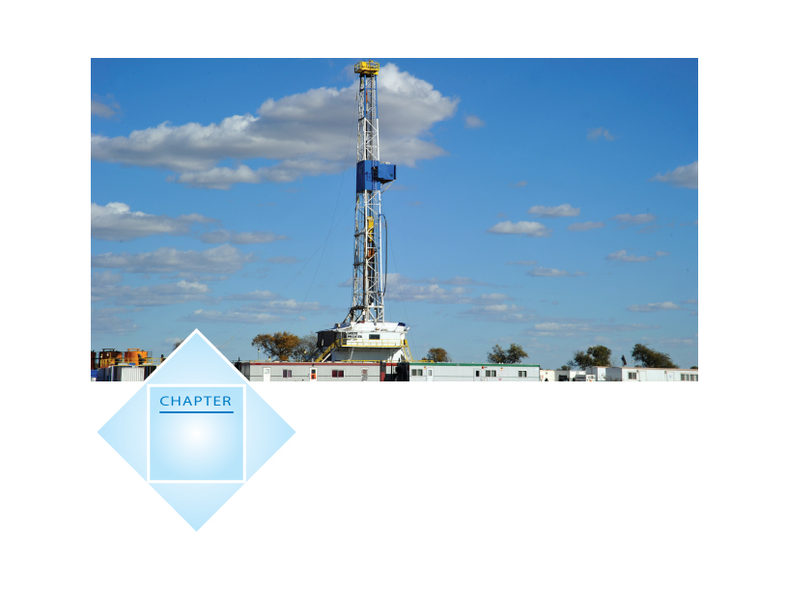
17
Markets for Factors
of Production

Slide 3
The Anatomy of Factor Markets
  Four factors of production are
  Labour
  Capital
  Land (natural resources)
  Entrepreneurship
  Let’s take a look at the markets in which these factors of production are traded.

Slide 4
The Anatomy of Factor Markets
  Market for Labour Services
  Labour services are the physical and mental work effort that people supply to produce goods and services.
  A labour market is a collection of people and firms who trade labour services.
  The price of labour services is the wage rate.
  Most labour markets have many buyers and many sellers and are competitive. In these labour markets, the wage rate is determined by supply and demand.

Slide 5
The Anatomy of Factor Markets
  Market for Capital Services
  Capital consists of the tools, instruments, machines, buildings, and other constructions that have been produced in the past and that businesses now use to produce goods and services.
  These physical objects are capital goods and capital goods are traded in goods markets. This market is not a market for capital services.
  A market for capital services is a rental market—a market in which the services of capital are hired.

Slide 6
The Anatomy of Factor Markets
  Markets for Land Services and Natural Resources
  Land consists of all the gifts of nature—natural resources. The market for land as a factor of production is the market for the services of land—the use of land.
  The price of the services of land is a rental rate.
  Nonrenewable natural resources are resources that can be used only once, such as oil, natural gas, and coal.
  The prices of nonrenewable natural resources are determined in global commodity markets.

Slide 7
The Anatomy of Factor Markets
  Entrepreneurship
  Entrepreneurship services are not traded in markets.
  Entrepreneurs receive the profit or bear the loss that results from their business decisions.

Slide 8
The Demand for a Factor of Production
  The demand for a factor of production is a derived demand—it is derived from the demand for the goods that it is used to produce.
  The quantities of factors of production demanded are a consequence of firms’ output decisions.
  A firm hires the quantities of factors of production that maximize its profit.

Slide 9
The Demand for a Factor of Production
  Value of Marginal Product
  The value to the firm of hiring one more unit of a factor is called its value of marginal product.
  Value of marginal product of a factor = Price of a unit of output × Marginal product of the factor

Slide 10
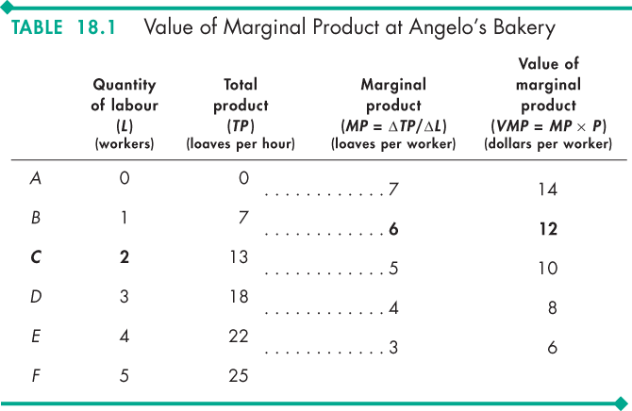
The Demand for a Factor of Production
  The table shows the calculation of VMP.
  From the firm’s total product schedule, calculate the marginal product of labour.
  VMP equals marginal product of labour multiplied by the market price of the good produced, which in this example is $2 a loaf.

Slide 11
The Demand for a Factor of Production
The Firm’s Demand for Labour
  The value of the marginal product of labour (VMP) tells us what an additional worker is worth to a firm.
  VMP tells us the revenue that the firm earns by hiring one more worker.
  The wage rate tells us what an additional worker costs a firm.
  VMP and the wage rate together determine the quantity of labour demanded by a firm.

Slide 12
The Demand for a Factor of Production
The firm maximizes its profit by hiring the quantity of labour at which VMP = the wage rate.
If VMP exceeds the wage rate, the firm can increase profit by employing one more worker.
If VMP is less than the wage rate, the firm can increase profit by firing one worker.
Only if VMP equals the wage rate is the firm maximizing profit.

Slide 13
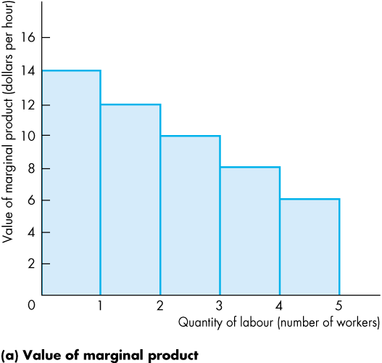
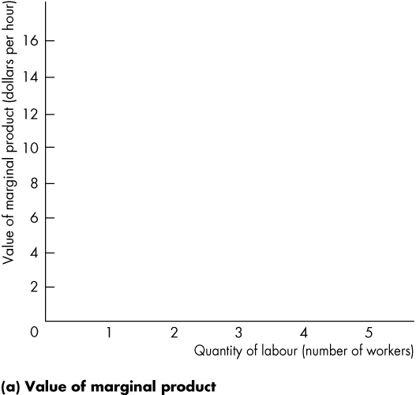
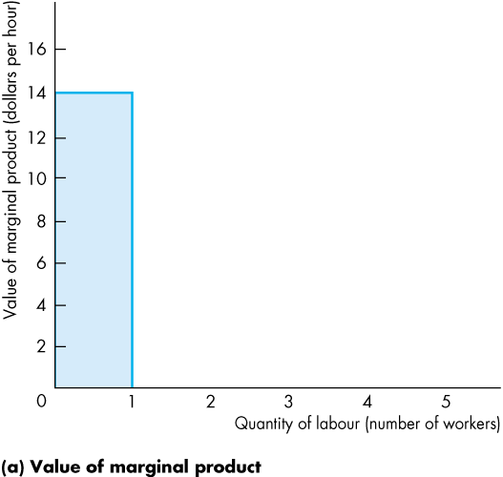
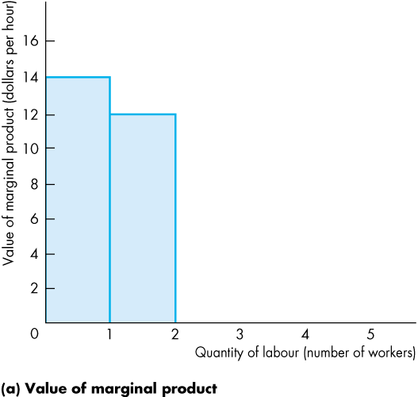
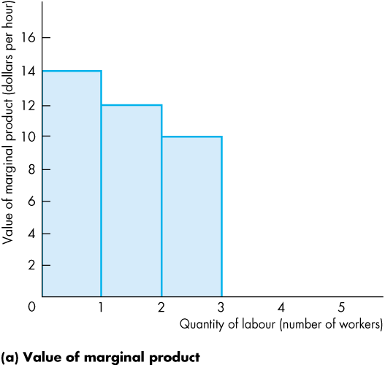
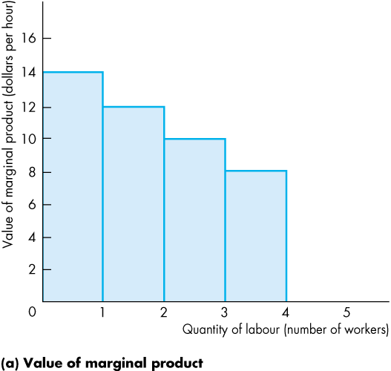
The Demand for a Factor of Production
  The figure shows the relationship between a firm’s value of marginal product and its demand for labour.
  The bars show the value of marginal product, which diminishes as the quantity of labour employed increases.

Slide 14
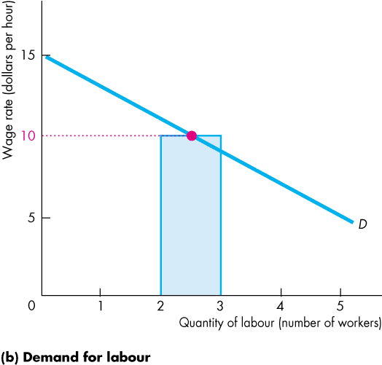
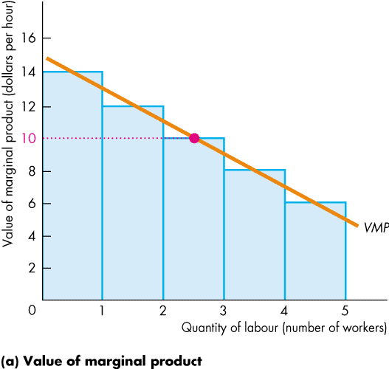
The Demand for a Factor of Production
  The value of marginal product curve passes through the midpoints of the bars.
  The VMP of the 3rd worker is $10 an hour.
  So at a wage rate of $10 an hour, the firm hires 3 workers on its demand for labour curve.

Slide 15
The Demand for a Factor of Production
Changes in a Firm’s Demand for Labour
  The firm’s demand for labour depends on
  The price of the firm’s output
  The prices of other factors of production
  Technology

Slide 16
The Demand for a Factor of Production
Changes in a Firm’s Demand for Labour
  The firm’s demand for labour depends on
  The price of the firm’s output
  The prices of other factors of production
  Technology

Slide 17
The Demand for a Factor of Production
The Price of the Firm’s Output
The higher the price of a firm’s output, the greater is the firm’s demand for labour.
The price of output affects the demand for labour through its influence on the value of marginal product of labour.
If the price of the firm’s output increases, the demand for labour increases and the demand for labour curve shifts rightward.

Slide 18
The Demand for a Factor of Production
The Price of Other Factors of Production
If the price of using capital decreases relative to the wage rate, a firm substitutes capital for labour and increases the quantity of capital it uses.
Usually, the demand for labour will decrease when the price of using capital falls.

Slide 19
The Demand for a Factor of Production
Technology
New technologies decrease the demand for some types of labour and increase the demand for other types.
For example, if a new automated bread-making machine becomes available, a bakery might install one of these machines and fire most of its workforce—a decrease in the demand for bakery workers.
But the firms that manufacture and service automated bread-making machines hire more labour, so there is an increase in the demand for this type of labour.

